Slide 1
Project Recovery (MGMT-6060)
Project Topic: Ottawa-Windsor Express Rail
Team Members (Team 09)
M M Navid Al Adnan (1169345)
Rona R. Bautista (0897048)
Hitenkumar B. Patel (1120292)
Ronisha Pokharel (1187263)
Gihan Shamike Liyanage (1142109)
Disclaimer: This project is created for academic purposes only. It is not sponsored by or reviewed by any real organizations discussed in this report.

Slide 2
Executive Summary Driving Economic Prosperity Along Ottawa to Windsor
Key Partners | Government Authorities Railway Construction Companies Technology Providers Maintenance Service Provider
Key Activities | Infrastructure Development Train Manufacturing Operations and Maintenance Technology Integration
Key Resources | High Speed Rail Infrastructure Skilled Workforce Technology and innovation High quality Machinery
Value Proposition | Environmental Benefit Less Time Consuming

Slide 3
Executive Summary Driving Economic Prosperity Along Ottawa to Windsor
Customer Relationship | Customer Service Loyalty Program Safety Assurance
Channels | Online Ticketing Platforms Station Ticket Counters Marketing and Advertising
Cost Structure | Fixed Cost: $ 25 Billion Variable: $ 700 million/year
Revenue Streams | Ticket Sale Rent from Stations from Coffee Shops and other shops Revenue from advertisement Estimated revenue is $800 million/year

Slide 4
Project Changes
Originally, the plan involved the construction of a new rail track. However, following careful consideration and guidance, we have decided to refine our focus to upgrading the existing rail corridor.
Additionally, we decided to change our project name from Ontario Bullet Train to Ottawa- Windsor Express Rail.
Furthermore, to streamline the project, we’ve removed certain stations, prioritizing efficiency and cost-effectiveness in our refined scope.
Cost from $5 Billion to $25 Billion projected financial amount.
Reference:
Bien, P., Iqbal, S., Li, A., Stecher, I., & Manger, M. (n.d.). Global Economic Policy Lab. Retrieved from High-Speed Rail: Toronto - Montreal

Slide 5
Company Description
Rail Transportation | About Canada Rail
A Vital Pillar of Canada's Infrastructure | Established: 1977 Headquarters: Montreal Key Leadership: Françoise Bertrand (Chairman) Mario Peloquin (CEO)
Vision Statement
Connecting Communities, Driving Progress.
Mission Statement | Core Values
To provide a seamless and efficient rail transportation network that fosters economic growth, enhances connectivity, and promotes sustainability. | Excellence: Striving for the highest standards in service and operations. Innovation: Embracing cutting-edge technologies for sustainable transportation. Collaboration: Fostering partnerships for mutual growth and community development. Safety: Prioritizing the well-being of passengers, employees, and the public.
Reference:
Canada, G. o. (n.d.). Rail transportation. Retrieved from tc.canada.ca
https://tc.canada.ca/en/rail-transportation

Slide 6
Industry Description
Key Trends | Market Dynamics
Intermodal Integration Seamless connection with other transport modes for comprehensive logistics. Technological Advancements Automation and data analytics for enhanced efficiency and safety. Sustainability Focus Commitment to eco-friendly practices, including electrification. Government Support Infrastructure investments and policy frameworks for robust rail connectivity. | Demand Growth Increasing demand for reliable transportation driven by economic expansion. Competitive Landscape Overview of key competitors and strategic partnerships. Regulatory Environment Impact of regulations and compliance requirements. Global Connectivity Rail's role in fostering international trade.
Reference:
Railway Association of Canada. (n.d.). Retrieved from railcan.ca:
https://www.railcan.ca/resources/

Slide 7
Project Objectives
Innovation: What is the product, service, technology or process to be created and delivered?
Product: High-Speed Bullet Train System:
The major product is a modern, high-speed bullet train. To run an advanced transportation system, this comprises the actual trains, rails, and related infrastructure.
Service: Fast and Efficient Passenger Transportation:
Transportation of passengers between major cities in a timely, dependable, and effective manner is the main offering. This includes efficient boarding procedures, comfortable travel experiences, and on-time arrivals and departures.
Technology: Electrified Rail Technology:
The trains are powered by electrified rail systems, which is an innovative technology. By lessening reliance on conventional diesel engines, this technology not only makes high-speed travel possible but also contributes to sustainable goals.
Process: Digital Integration for User-Friendly Experience:
To improve the entire travel experience, provide a user-friendly digital environment with interactive maps, online ticketing, and real-time information. Through digital integration, the trip will be more accessible and comfortable for travelers by easing every aspect of it, from preparation to execution.

Slide 8
Project Objectives
Marketing: How will the outcome of the project meet market needs, and how will the project be communicated?
Get a reliable transportation for the passengers who travel regularly:
For travellers who often travel between large cities, the installation of a high-speed bullet train system offers a dependable and effective means of transportation. The train is a desirable alternative for commuters due to its speed and regularity.
Lesser use of diesel vehicles:
Since most bullet trains run on electricity, there is less need for diesel cars on the road. This helps to reduce air pollution and reliance on fossil fuels, which is in line with encouraging sustainable means of transportation.
In major cities, it's costly to park:
The project intends to reduce the need for large parking facilities in urban areas by connecting major cities with a high-speed rail network. The ease and cost-effectiveness of parking are eliminated for travellers between cities, encouraging a more effective use of available urban space.

Slide 9
Project Objectives
Marketing: How will the outcome of the project meet market needs, and how will the project be communicated?
Solve the housing problems:
By making it simpler to commute between cities and suburbs, high-speed rail can help with housing concerns. With the speedy and dependable bullet train service, people may reside in more reasonably priced neighbourhoods outside of large cities and yet have easy access to amenities and employment possibilities.
Tourism industry:
A bullet train system's implementation boosts the transport and tourism sector by facilitating quicker and easier transit between popular tourist locations. Because they may visit more cities in less time, tourists can promote tourism as a major economic engine and help local economies in different locations

Slide 10
Expected Benefits – Economic Value
Reduced Congestion Costs:
Airport and road traffic congestion can be reduced with the use of high-speed rail. Lower expenses for delays in time, fuel use, and traffic congestion-related maintenance of infrastructure result from this reduction in congestion.
Growth in Tourism and Hospitality Industry:
High-speed rail will boost tourism by helping people to reach any tourist place very quickly. It will automatically increase revenue from restaurants, local shops and attractions, hotels etc.
Job Opportunities:
Jobs in the engineering, construction, maintenance, and service sectors are all created by the building and running of a bullet train system. Both direct employment in the rail sector and indirect jobs in associated industries are included in its overall impact on the economy.
Business Opportunities:
Enhanced connection has the potential to draw in enterprises and promote economic growth in areas covered by the bullet train system. The improved transportation network might attract additional investment, which would boost the economy and create jobs.
Reference:
Business Today.In. Sept. 14, 2014. India On Track To Get Its First Bullet Train: Benefits And Challenges In PM Modi's Dream Project
https://www.businesstoday.in/latest/economy-politics/story/india-on-track-to-get-first-its-bullet-train-benefits-and-challenges-in-pm-modi-dream-project-ahmedabad-mumbai-82253-2017-09-14

Slide 11
Expected Benefits - Social
Enhanced Quality of Life:
The comfort of use and effectiveness of high-speed rail transit enhances the standard of living for locals. This is particularly true for people whose personal, professional, and educational pursuits depend on reliable transportation.
Culture Exchange:
Enhanced inter-regional connectivity promotes both tourist and cultural exchange. When transportation is reliable and easily accessible, people are more inclined to travel around and experience different sections of a place.
Time Saving:
Distances between destinations can be travelled much faster using high-speed trains. People who save time on their commutes can be more productive since they can devote more of their time to work or other interests.
Reference:
Graham, E. December 31, 2023. NCESC.com. What Is A Social Impact Of The Bullet Train?
https://www.ncesc.com/what-is-a-social-impact-of-the-bullet-train/

Slide 12
Expected Benefits – Environmental Accountability
Noise and Vibration: -
Vibration and noise from high-speed trains can affect the surrounding communities, particularly those living close to the tracks. To lessen the effect on locals and wildlife, noise reduction strategies including sound barriers and appropriate track design should be considered.
Carbon Emission: -
Air travel and regular cars generate more carbon emissions per passenger kilometer than bullet trains. But one should also consider the emissions related to building and maintaining rail infrastructure. The project's carbon footprint can be further decreased by trying to employ cleaner energy sources.
Waste Produce: -
Waste from construction projects can be produced in large quantities. To reduce the environmental impact, proper waste management procedures should be followed, including recycling and disposal. Efficiency can also be enhanced by initiatives to cut waste throughout the operational period, such as effective maintenance procedures.
Reference:
Escholarship Community Encyclopedia. n.d. Environmental Aspect of Rail Transport
https://encyclopedia.pub/entry/49333

Slide 13
Preliminary Project Cash Flows
Cash Outflow:
Project Cost: We are going to renovate the existing rail tracks which will support the bullet train. We are also going to renovate the train station to accommodate bullet train operation. Also, there are other items like- the purchase of bullet train units, equipment, technology, etc. The estimated project cost will be around 25 Billion Canadian Dollars. There is another project, but it is covering Toronto to Montreal, and it is estimated to be $21 Billion (Bien, Iqbal, Li, Stecher, & Manger). Since the distance is 100km more in our project, we are estimating the cost to be more than other Toronto-Montreal Projects.
Funding: Canadian National Railway is going to conduct the projects and therefore, the project will be funded by the federal government.
Operating Expense: Operating expense is estimated to be around $700 Million per year.
Cash Inflow:
Revenue: We are estimating the annual revenue to be $800 Million per year.
Reference:
Bien, P., Iqbal, S., Li, A., Stecher, I., & Manger, M. (n.d.). Global Economic Policy Lab. Retrieved from High-Speed Rail: Toronto - Montreal

Slide 14
Preliminary Stakeholder Register
The Government of Canada has established the High-Frequency Rail (HFR).
Transport Canada – Project Authority leading the project (on behalf of the Minister of Transport).
Members (supported by the Department of Justice)
Infrastructure Canada
Public Services
Procurement Canada
VIA HFR
Additional stakeholders are
Landowners
Communities
Environmental Groups
Reference:
Borealis. n.d. The Challenge. Building on Lessons Learned.
https://www.boreal-is.com/use-case-rail-industry/

Slide 15
Preliminary Stakeholder Register
As rail projects are planned, built and maintained over time, the team must constantly develop an engagement plan for a host of issues and stakeholder groups. Listed below are the potential needs of the stakeholders and solutions;
Creating a central registry of all individuals, organizations and households that are stakeholders in this railway project.
Unify all your stakeholder information under one platform by importing their information into databases quickly and easily.
Map them along with their affiliations to better understand their influence and concerns.
We will use handy reporting features to give management a real-time picture of the ever-evolving stakeholder relationship landscape.
Reference:
Borealis. n.d. Stakeholder Engagement Platform. How To Engage Stakeholders And Strengthen Your Strategy
https://www.boreal-is.com/modules/stakeholder-engagement

Slide 16
Preliminary Stakeholder Register
Stakeholder engagement can help the organization achieve better outcomes, whether it is education, connection, engagement or profit.
Empower people – Get stakeholders involved in the decision-making process.
Create sustainable change – Engaged stakeholders help inform decisions and provide the support that the organization needs for long-term sustainability.
Build relationships – Create mutually beneficial relationships, build on existing relationships or foster new ones.
Build a better organization – Engaging with stakeholders can bring important issues to light and encourage the organization to develop corporate social responsibility.
Increase success – Engaging influential groups and turning them into supporters and advocates can boost the organization’s chances of success.
Educate – Stakeholders can be a valuable source of information for the organization, and they may learn something from it.
Reference:
Hendricks, A. n.d. Simply Stakeholders. The Importance of Stakeholders: Identifying and Prioritizing Stakeholder Engagement.
https://simplystakeholders.com/the-importance-of-stakeholders/

Slide 17
Required Resources - People Involve
Stakeholders | These are the group of people that overall approved the whole project, from the requirement, design, initiation and closing of the project
PMO and Team | Professionals who organize, plan, and execute projects while working within restraints like budgets and schedules. Project managers lead entire teams, define project goals, communicate with stakeholders, and see a project through to its closure
HSE Team | Collaborate with law enforcement agencies to ensure security measures are in place.
R&D Team | Develop detailed engineering plans for every aspect of the project, including track alignment, station layouts, bridges, tunnels, signaling systems, and power supply.
Procurement | Creating bidding documents for suppliers and contractors.
Reference:
Staff, C. November 29, 2023. Cousera. What Is A Project Manager? A Career Guide.
https://www.coursera.org/articles/what-is-project-manager
Jain, S. Aug. 12, 2023. Medium. “Forging the Path: The Construction of Bullet Train Tracks”
https://medium.com/@samarthjain/forging-the-path-the-construction-of-bullet-train-tracks-d2099a0cd11c

Slide 18
Required Resources - People Involve
Logistics and Whse Team | Initiate transportation and proper storage of raw and finished products
TL and Laborers | Ground workers
IT Team | IT is also used to improve operations, and in a way, it is also linked to scheduling. Optimization can go in several directions: better train control, dispatching, or customer information system.
3rd Party Testing Commissioning Team | Conduct a series of tests to ensure the safety and functionality of the infrastructure, signalling systems, and trains.
Reference:
Staff, C. November 29, 2023. Cousera. What Is A Project Manager? A Career Guide.
https://www.coursera.org/articles/what-is-project-manager#

Slide 19
Required Resources – Physical Equipment
Land Properties, for warehouse, offices and temporary on-site facility
Construction materials, tools and equipment
Heavy Equipment: Mobile crane, Forklift, Trucks, Locomotives, Hi-Rail Vehicles, Buggies and Gondola
Steel, Frames and Beams other wooden materials
Gauges and other measuring and calibrating equipment
Reference:
Wikipedia. n.d. Railway Track
https://en.wikipedia.org/wiki/Railway_track/

Slide 20
Required Resources - Time
The old railway construction began in 1881 and took four years to complete in 1885. When was the Canadian Pacific Railway completed? On November 7, 1885, the "Last Spike" was driven at Craigellachie in Eagle Pass, British Columbia, to meet the line to the Pacific coast.
Based on WBS a High-Speed Railway from Windsor to Ottawa may take, 4650 Days to complete this project is 12 to 13 years in the making. From conceptualization, planning, approvals, execution, testing and commissioning and finally turn-over to the client.
Reference:
Camilleri, C. Mar. 2, 2023. Canadian Train Vacations. Canadian Pacific Railways Facts
https://canadiantrainvacations.com/blog/canadian-pacific-railway-facts#

Slide 21
Required Resources – Funding
Transport Canada’s Rail Safety Improvement Program (RSIP) provides funding for projects that improve infrastructure or propose research or new technologies to increase safety at grade crossings and along rail lines or that address or prevent the impact of climate change and extreme weather along rail lines. Projects that increase public confidence in Canada’s rail transportation system or education and awareness about rail safety issues are also funded.
Reference:
Government of Canada. n.d. Rail Safety Improvement Program
https://tc.canada.ca/en/programs/funding-programs/rail-safety-improvement-program

Slide 22
Preliminary Description of Any Technology
Design and Planning:
Detailed possibility studies are carried out to evaluate the project's feasibility before construction, considering variables such as cost, environmental impact, and route selection.
The route is planned by engineers considering variables like topography, population density, and the state of the infrastructure. High-speed trains need straight tracks with mild curves.
Construction Equipment:
Generally, TBMs are utilized for tunnelling. These enormous devices are capable of boring tunnels with little disturbance to the surface through rock and dirt. The tracks are precisely laid and aligned using specialized machinery. The purpose of high-speed rail tracks is to provide efficient, stable, and smooth transport. The need for bridges and viaducts may arise from the topography. These raised constructions are built with specialized machinery.
Reference:
Jain, S. Aug. 12, 2023. Medium. “Forging the Path: The Construction of Bullet Train Tracks”
https://medium.com/@samarthjain/forging-the-path-the-construction-of-bullet-train-tracks-d2099a0cd11c

Slide 23
Preliminary Description of Any Technology
Preparation of the land involves the employment of excavators, bulldozers, and other earthmoving equipment, particularly in regions where levelling tracks are necessary. For the construction of the tracks, stations, and other structures, high-quality concrete is essential. Large volumes of concrete are produced using batch facilities.
Infrastructure and structure:
The speed and volume of passengers are accommodated in the architecture of high-speed rail stations. Platforms, ticketing areas, security, and frequently commercial areas are among them. These are made to guarantee a safe and easy journey. Bridges must endure high-speed loads and environmental conditions, while tunnels can need ventilation mechanisms.
Technology and System:
To ensure both safety and effectiveness, modern train control systems regulate the speed and spacing of trains. Signaling and communication systems fall under this category.
Reference:
Jain, S. Aug. 12, 2023. Medium. “Forging the Path: The Construction of Bullet Train Tracks”
https://medium.com/@samarthjain/forging-the-path-the-construction-of-bullet-train-tracks-d2099a0cd11c

Slide 24
Preliminary Description of Any Technology
Advanced technology such as regenerative braking systems, tilting mechanisms, and aerodynamic designs are featured in high-speed trains. Power supply systems, which frequently make use of extra rails or overhead wiring, are necessary for electrified high-speed rail lines. The general design incorporates several safety elements, including fire detection, emergency braking systems, and evacuation protocols.
Hardware and Software:
Tracks, stations, and infrastructure are designed using computer-aided design (CAD) software.
Project management software (MS Project) is used for scheduling, resource allocation, and cooperation in the construction process management process.
Track alignment and levelling are precisely ensured using high-precision surveying equipment.
To ensure the safety of operations and to coordinate construction activities, advanced communication technologies are necessary.
Tunnel integrity is checked both during and after construction using specialized tools.
Reference:
Agico Group. Feb 10, 2017. How To Build A Railway Track?
http://www.railway-fasteners.com/news/how-to-build-a-railway-track.html

Slide 25
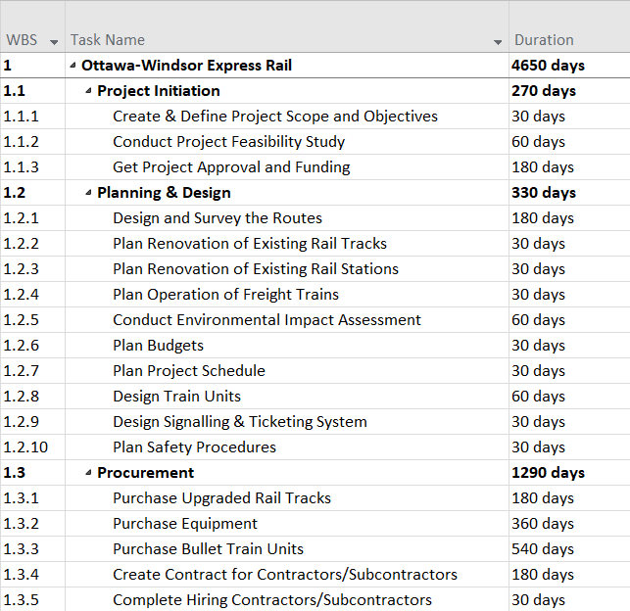
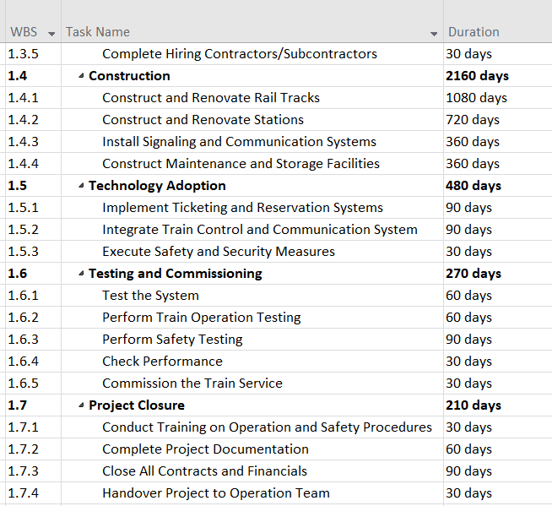
Work Breakdown Structure and Schedule
Reference:
High-speed rail. (n.d.). Retrieved from Ontario.ca
https://www.ontario.ca/page/high-speed-rail

Slide 26
Summary of References
Bien, P., Iqbal, S., Li, A., Stecher, I., & Manger, M. (n.d.). Global Economic Policy Lab. Retrieved from High-Speed Rail: Toronto - Montreal
Canada, G. o. (n.d.). Rail transportation. Retrieved from tc.canada.ca
https://tc.canada.ca/en/rail-transportation
Railway Association of Canada. (n.d.). Retrieved from railcan.ca:
https://www.railcan.ca/resources/
Business Today.In. Sept. 14, 2014. India On Track To Get Its First Bullet Train: Benefits And Challenges In PM Modi's Dream Project
https://www.businesstoday.in/latest/economy-politics/story/india-on-track-to-get-first-its-bullet-train-benefits-and-challenges-in-pm-modi-dream-project-ahmedabad-mumbai-82253-2017-09-14
Graham, E. December 31, 2023. NCESC.com. What Is A Social Impact Of The Bullet Train?
https://www.ncesc.com/what-is-a-social-impact-of-the-bullet-train/
Escholarship Community Encyclopedia. n.d. Environmental Aspect of Rail Transport
https://encyclopedia.pub/entry/49333
Borealis. n.d. The Challenge. Building on Lessons Learned.
https://www.boreal-is.com/use-case-rail-industry/
Borealis. n.d. Stakeholder Engagement Platform. How To Engage Stakeholders And Strengthen Your Strategy
https://www.boreal-is.com/modules/stakeholder-engagement

Slide 27
Summary of References
Hendricks, A. n.d. Simply Stakeholders. The Importance of Stakeholders: Identifying and Prioritizing Stakeholder Engagement.
https://simplystakeholders.com/the-importance-of-stakeholders/
Staff, C. November 29, 2023. Cousera. What Is A Project Manager? A Career Guide.
https://www.coursera.org/articles/what-is-project-manager
Wikipedia. n.d. Railway Track
https://en.wikipedia.org/wiki/Railway_track/
Camilleri, C. Mar. 2, 2023. Canadian Train Vacations. Canadian Pacific Railways Facts
https://canadiantrainvacations.com/blog/canadian-pacific-railway-facts#
Government of Canada. n.d. Rail Safety Improvement Program
https://tc.canada.ca/en/programs/funding-programs/rail-safety-improvement-program
Jain, S. Aug. 12, 2023. Medium. “Forging the Path: The Construction of Bullet Train Tracks”
https://medium.com/@samarthjain/forging-the-path-the-construction-of-bullet-train-tracks-d2099a0cd11c
Agico Group. Feb 10, 2017. How To Build A Railway Track?
http://www.railway-fasteners.com/news/how-to-build-a-railway-track.html
High-speed rail. (n.d.). Retrieved from Ontario.ca
https://www.ontario.ca/page/high-speed-rail

